Slide 1
Representing Curves and Surfaces

Slide 2
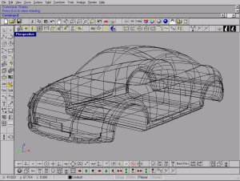
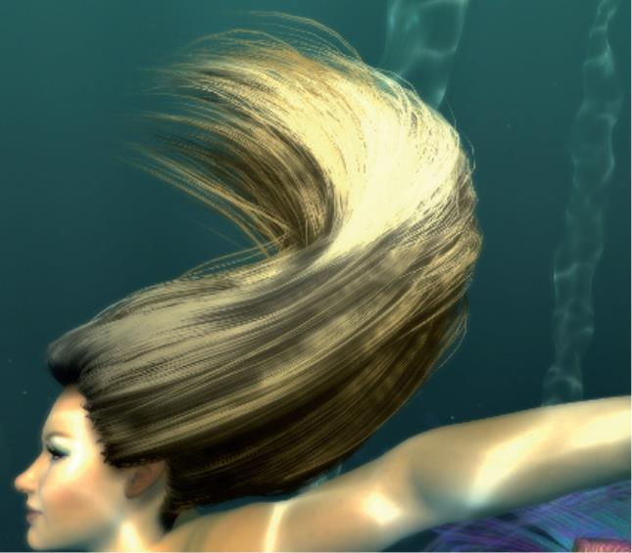
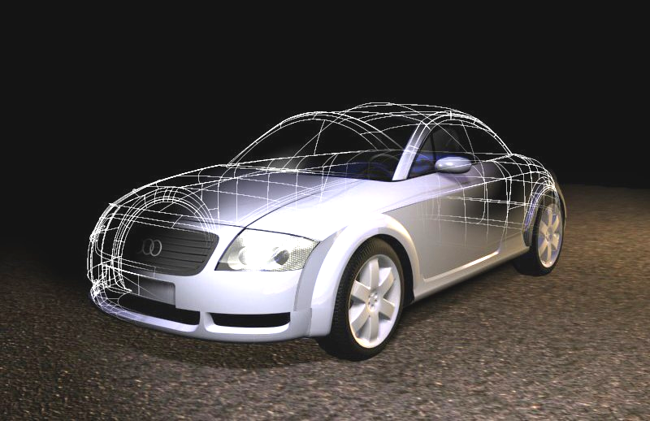
Hair rendering using tessellated cubic curves

Slide 3
Representation of Curves & Surfaces
Polygon Meshes
Parametric Cubic Curves
Parametric Bi-Cubic Surfaces
Quadric Surfaces
Specialized Modeling Techniques

Slide 4
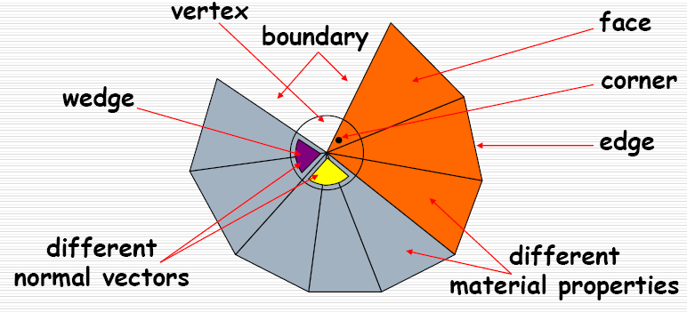
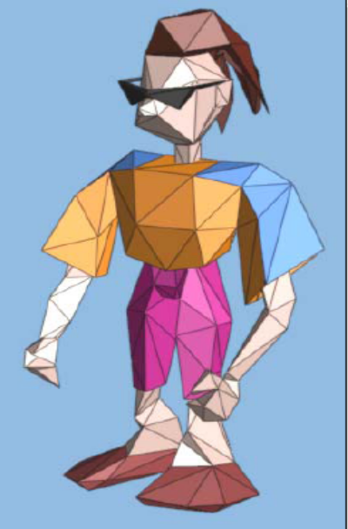
Polygon Mesh
A Collection of edges, vertices and polygons connected such that each edge is shared by at most two polygons.

Slide 5
Representing Polygon Meshes
explicit representation
    By a list of vertex coordinates
pointers to a vertex list
pointers to a edge list

Slide 6
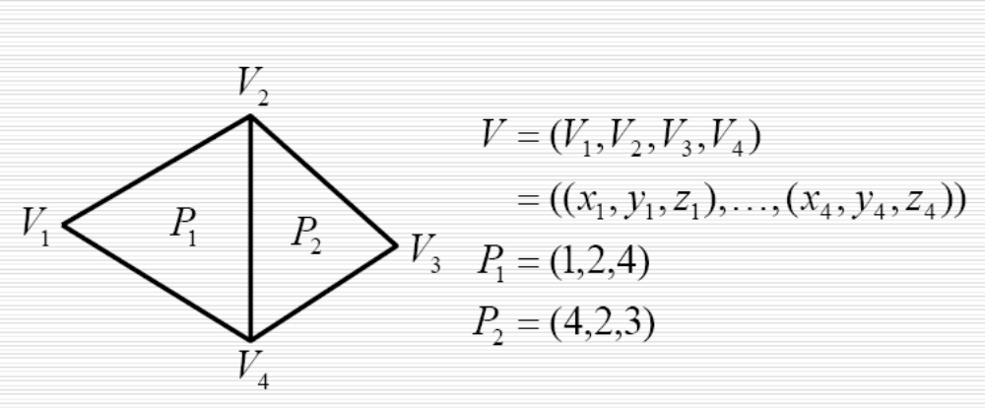
pointers to a vertex list

Slide 7
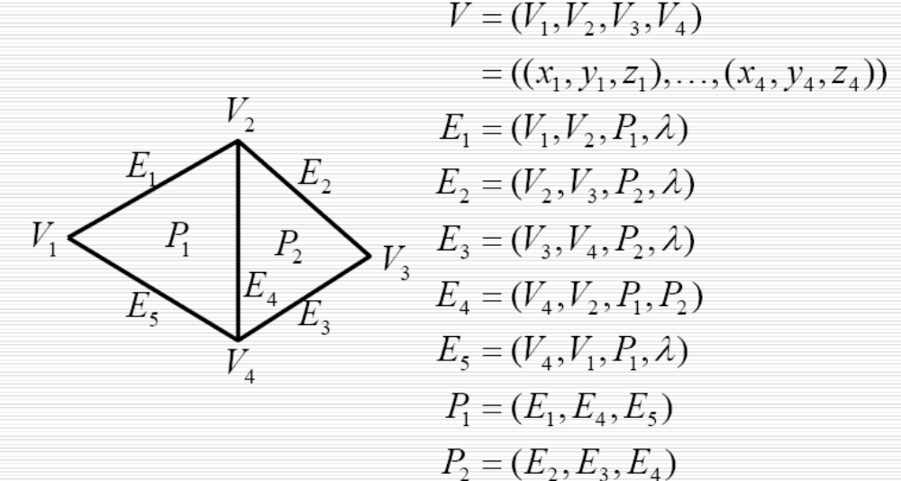
Pointers to a edge list

Slide 8

Plane Equations
Ax + By + Cz + D = 0
    (A,B,C) is the normal vector
    so ,given points P₁,P₂ and P₃ on the plane,
    (A,B,C) = P₁P₂ X P₁P₃
    the distance d for the vertex at (x,y,z) is
    If there are more than 3 points, they may be nonplanar, so triangle mesh is used most.

Slide 9
Class Mesh
class Point3 {public: float x,y,z;}
class Vector3 {public: float x,y,z;}
class VertexID { public: int vert_idx; int norm_idx;}
class Face { public: int nvert; VertexID *vert; }
class Mesh{
private: int numV; Point3 *pt;
int numNorm; Vector3 *norm;
int numFaces; Face* face; }

Slide 10
Mesh::Draw
for(each face in this mesh )
{
glBegin(GL_POLYGON);
for( each vertex in this face)
{
glNormal3f(normal of this vertex);
glVertex3f(posistion of this vertex)；
}
glEnd();
}

Slide 11
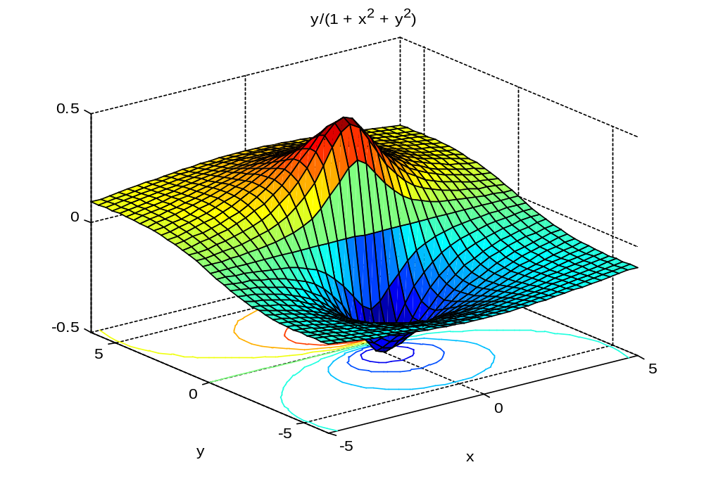
Polygon Meshes of curve surface is approximate

Slide 12
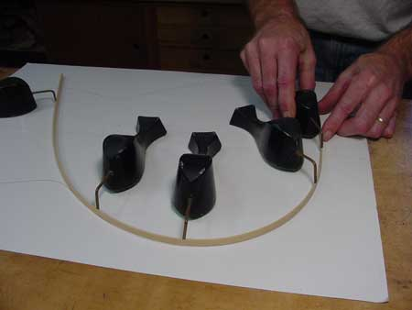
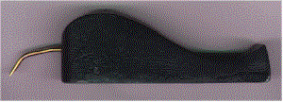
Parametric Curves: Splines

Slide 13
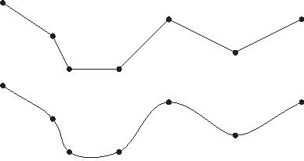
Representations of Curves
Problems with series of points used to model a curve
  Piecewise linear - Does not accurately model a smooth line
  It’s tedious
  Expensive to manipulate curve because all points must be repositioned
Instead, model curve as piecewise-polynomial
  x = x(t), y = y(t), z = z(t)
    where x(), y(), z() are polynomials

Slide 14
The beauty of using curves and curved surfaces
They have a more compact representation than a set of triangles
they provide scalable geometric primitives
they provide smoother and more continuous primitives than straight lines and planar triangles
animation and collision detection may become simpler and faster ( since a much smaller number of points needs to be animated )

Slide 15
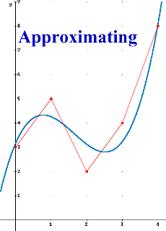
Specifying Curves
Control Points
  A set of points that influence the
  curve’s shape
Knots
  Control points that lie on the curve
Interpolating Splines
  Curves that pass through the control
  points (knots)
Approximating Splines
  Control points merely influence shape

Slide 16
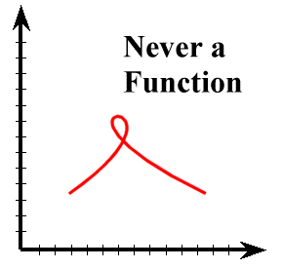
Parametric Curves
Very flexible representation
They are not required to be functions
  They can be multivalued with respect to any dimension

Slide 17
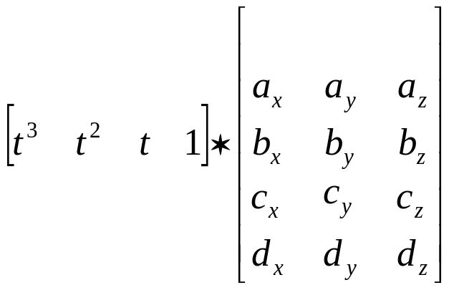
Cubic Polynomials
x(t) = a_{x}t³ + b_{x}t² + c_{x}t + d_{x}
  Similarly for y(t) and z(t)
Let t: (0 <= t <= 1)
Let T = [t³ t² t 1]
Coefficient Matrix C
Curve: Q(t) = T*C

Slide 18
Parametric Curves
How do we find the tangent to a curve?
  If f(x) = x² – 4
    tangent at (x=3) is f’(x) = 2 (x) – 4 = 2 (3) - 4
Derivative of Q(t) is the tangent vector at t:
  d/dt Q(t) = Q’(t) = d/dt T * C = [3t² 2t 1 0] * C

Slide 19
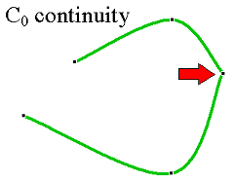
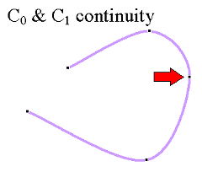
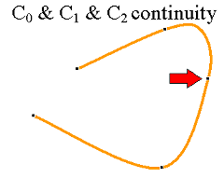
Piecewise Curve Segments
One curve constructed by connecting many smaller segments end-to-end
Continuity describes the joint
  C₁ is tangent continuity (velocity)
  C₂ is 2nd derivative continuity (acceleration)

Slide 20
Continuity of Curves
If direction (but not necessarily magnitude) of tangent matches
  G¹ geometric continuity
  The tangent value at the end of one curve is proportional to the tangent value of the beginning of the next curve
Matching direction and magnitude of d^{n} / dt^{n}
    C^{n} continous

Slide 21
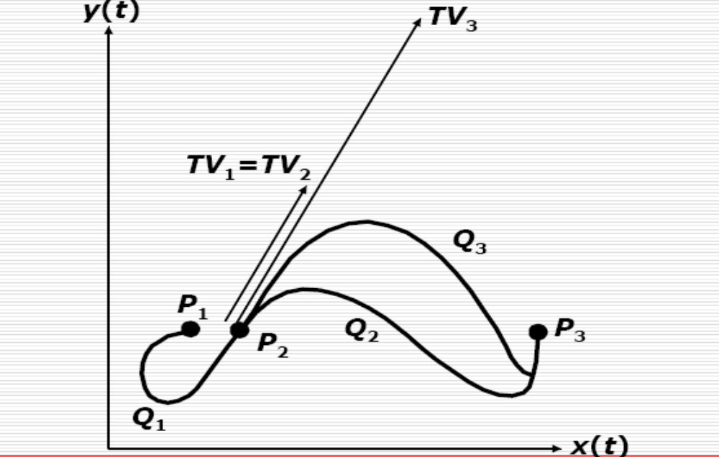
Continuity between Curves Segments

Slide 22
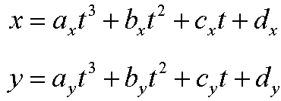
Parametric Cubic Curves
In order to assure C² continuity, curves must be of at least degree 3
Here is the parametric definition of a cubic (degree 3) spline in two dimensions
How do we extend it to three dimensions?

Slide 23
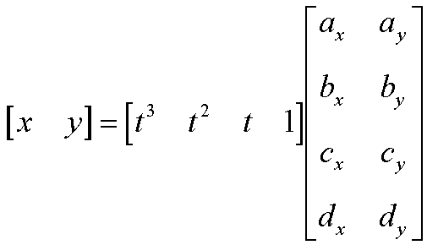
Parametric Cubic Splines
Can represent this as a matrix too

Slide 24
Coefficients
So how do we select the coefficients?
  [a_{x} b_{x} c_{x} d_{x}] and [a_{y} b_{y} c_{y} d_{y}] must satisfy the constraints defined by the knots and the continuity conditions

Slide 25
Parametric Curves
Difficult to conceptualize curve as
x(t) = a_{x}t³ + b_{x}t² + c_{x}t + d_{x}
(artists don’t think in terms of coefficients of cubics)
Instead, define curve as weighted combination of 4 well-defined cubic polynomials
(wait a second! Artists don’t think this way either!)
Each curve type defines different cubic polynomials and weighting schemes

Slide 26
Parametric Curves
Hermite – two endpoints and two endpoint tangent vectors
Bezier - two endpoints and two other points that define the endpoint tangent vectors
Splines – four control points
  C1 and C2 continuity at the join points
  Come close to their control points, but not guaranteed to touch them

Slide 27
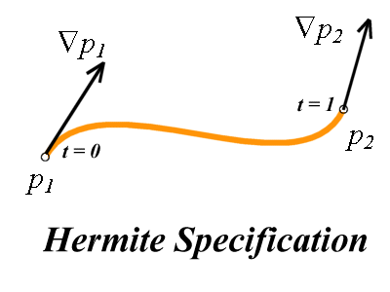
Hermite Cubic Splines
An example of knot and continuity constraints

Slide 28
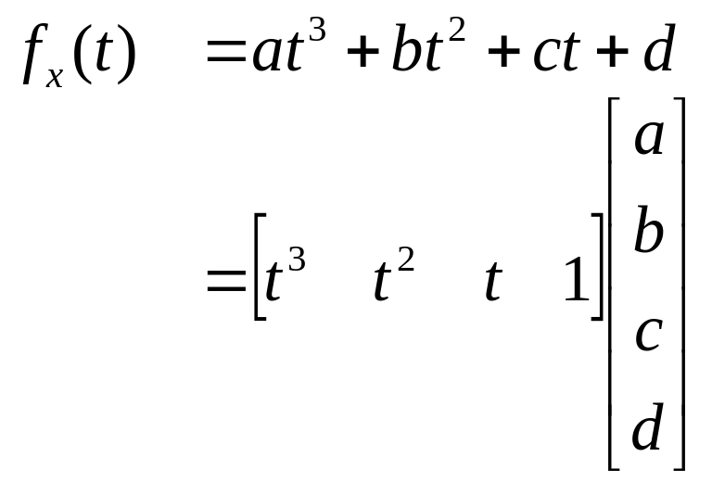
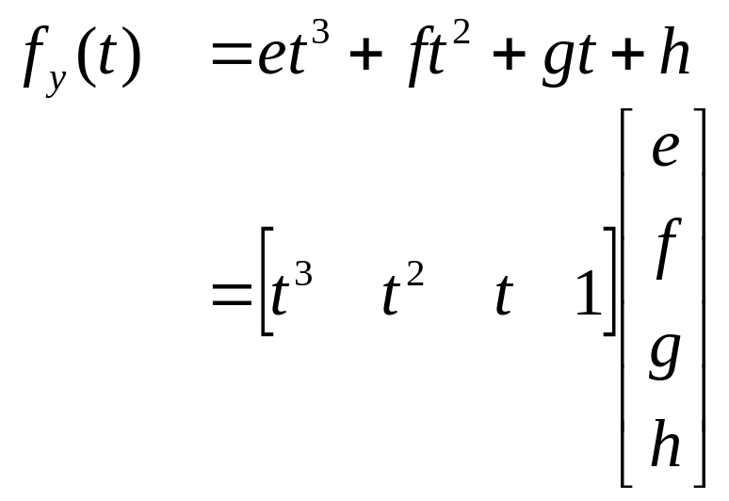
Hermite Cubic Splines
One cubic curve for each dimension
A curve constrained to x/y-plane has two curves:

Slide 29
Hermite Cubic Splines
A 2-D Hermite Cubic Spline is defined by eight parameters: a, b, c, d, e, f, g, h
How do we convert the intuitive endpoint constraints into these (relatively) unintuitive eight parameters?
We know:
  (x, y) position at t = 0, p₁
  (x, y) position at t = 1, p₂
  (x, y) derivative at t = 0, dp/dt
  (x, y) derivative at t = 1, dp/dt

Slide 30
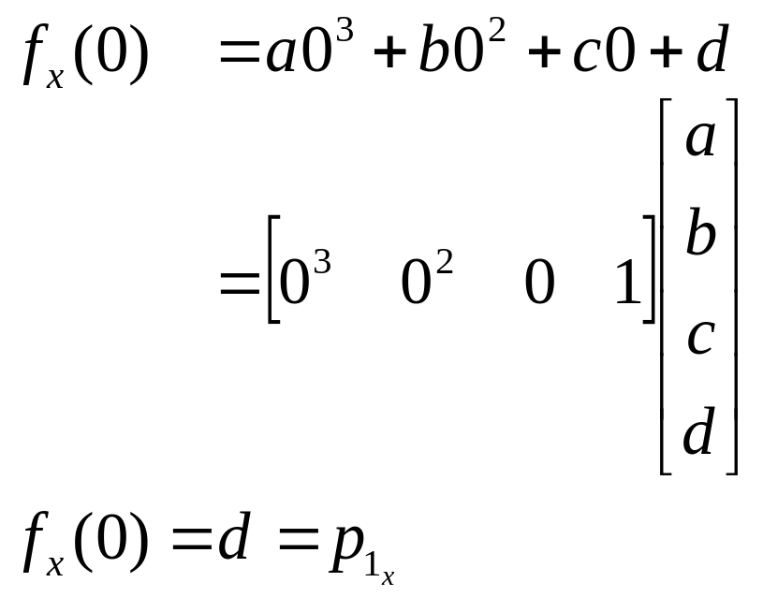
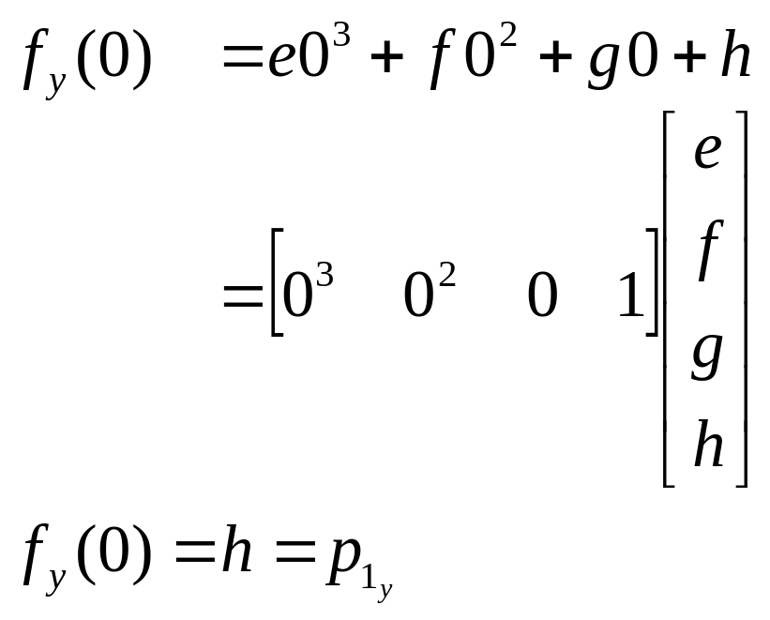
Hermite Cubic Spline
We know:
  (x, y) position at t = 0, p₁

Slide 31
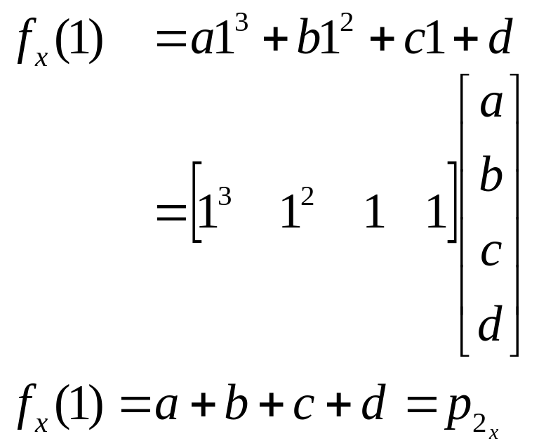
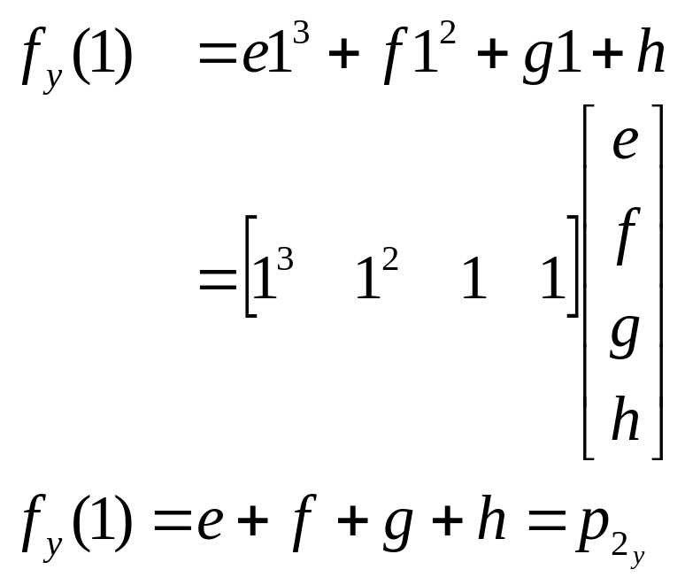
Hermite Cubic Spline
We know:
  (x, y) position at t = 1, p₂

Slide 32
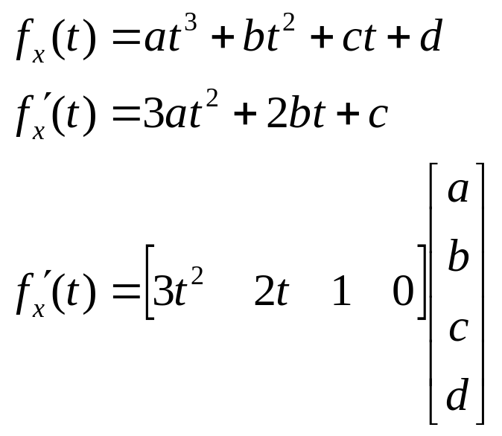
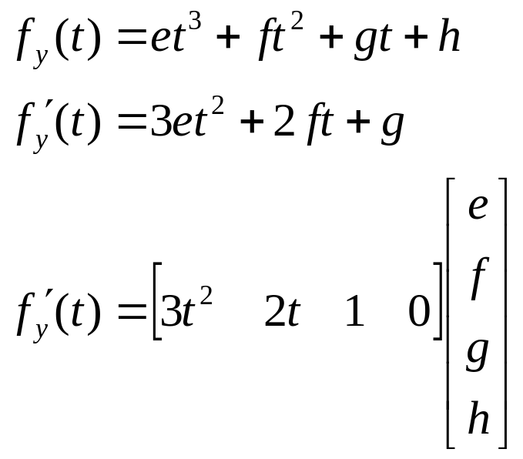
Hermite Cubic Splines
So far we have four equations, but we have eight unknowns
Use the derivatives

Slide 33
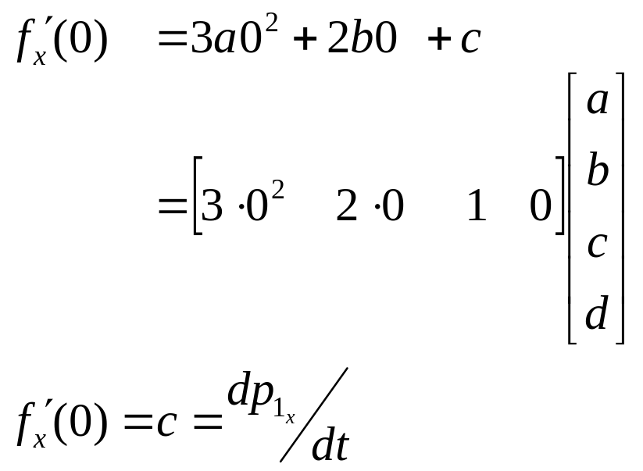
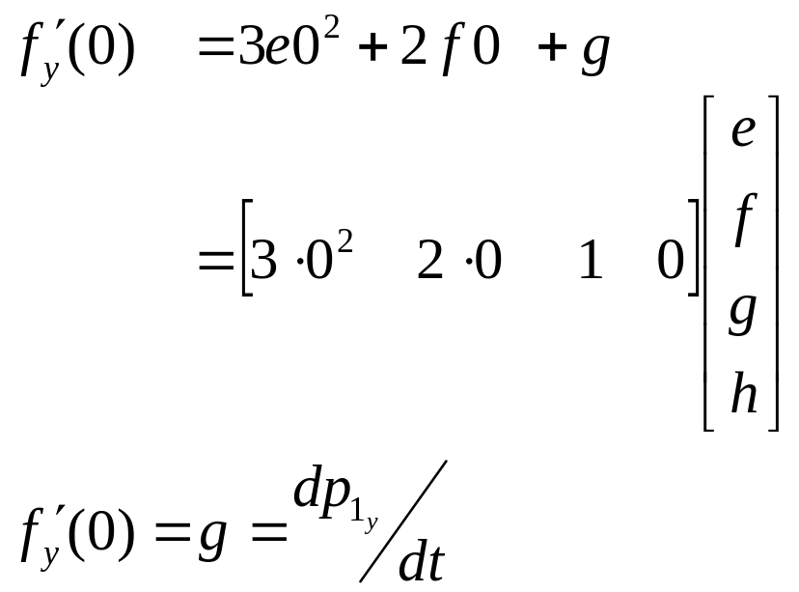
Hermite Cubic Spline
We know:
  (x, y) derivative at t = 0, dp/dt

Slide 34
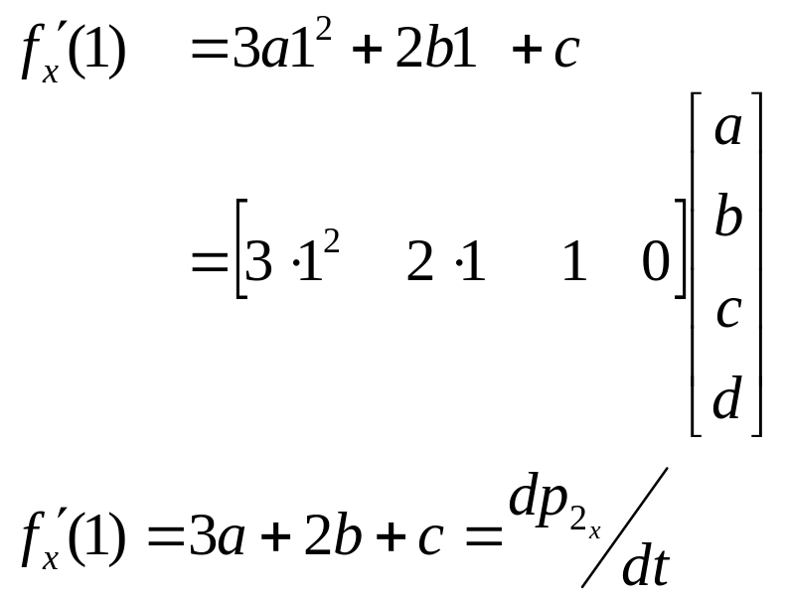
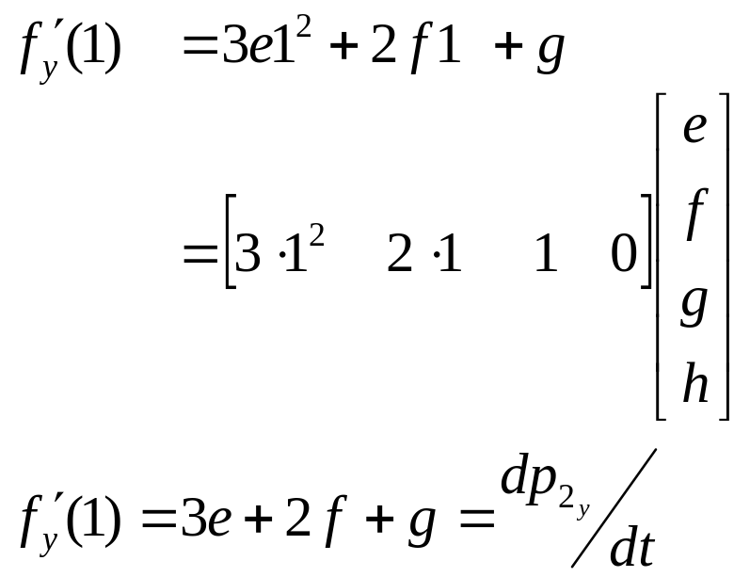
Hermite Cubic Spline
We know:
  (x, y) derivative at t = 1, dp/dt

Slide 35
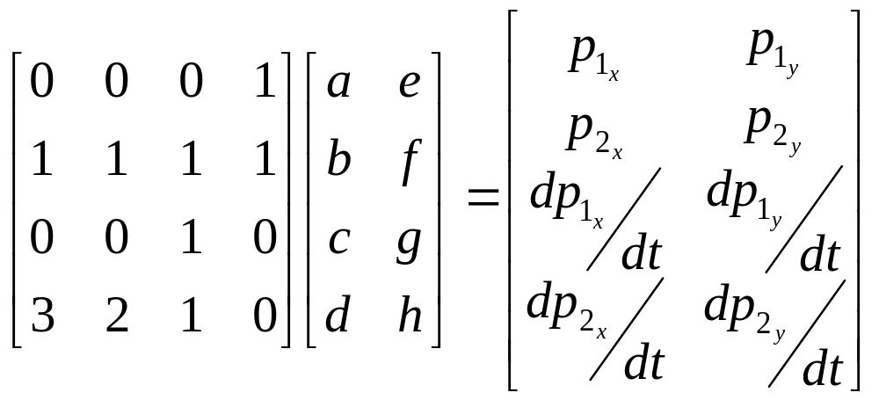
Hermite Specification
Matrix equation for Hermite Curve
t³ t² t¹ t⁰
t = 0
p₁
p₂
t = 1
t = 0
r p₁
r p₂
t = 1

Slide 36
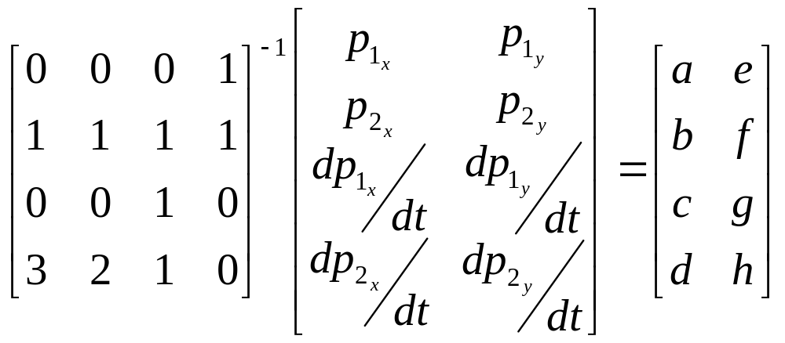
Solve Hermite Matrix

Slide 37
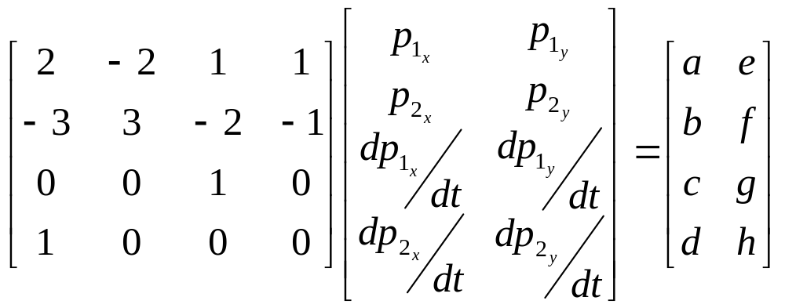
Spline and Geometry Matrices
M_{Hermite}
G_{Hermite}
C_{Hermite}

Slide 38
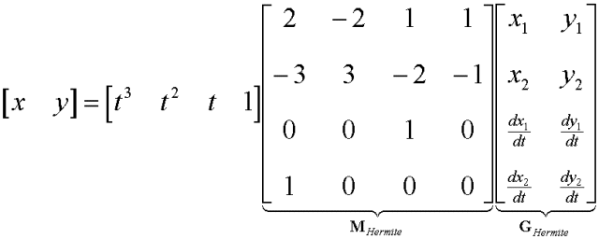
Resulting Hermite Spline Equation

Slide 39
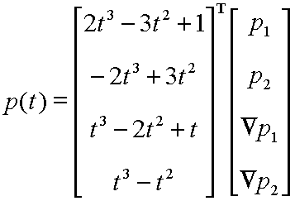
Blending Functions
By multiplying first two matrices in lower-left equation, you have four functions of ‘t’ that blend the four control parameters
These are blending functions

Slide 40
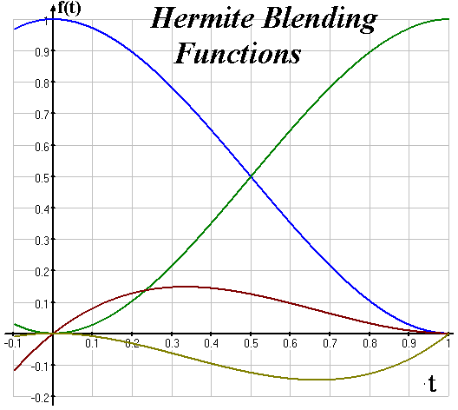
Hermite Blending Functions
Remember, each
blending function
reflects influence
of P₁, P₂, ΔP₁ΔP₂
on spline’s shape

Slide 41
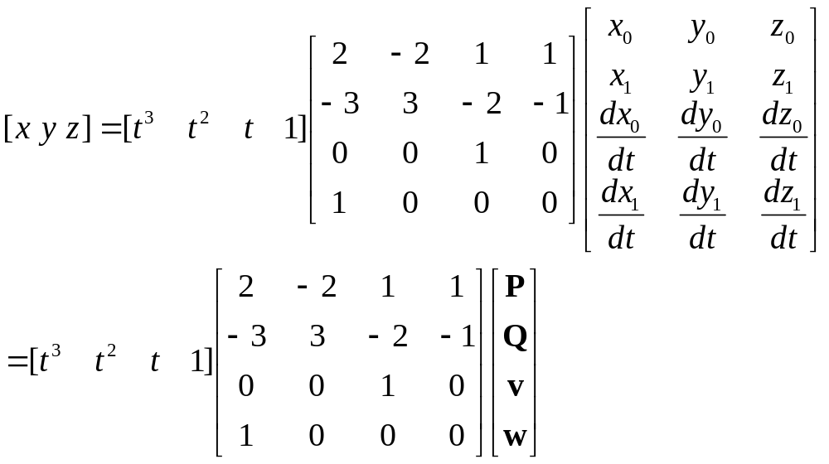
Resulting Hermite Spline Equation（3D）

Slide 42
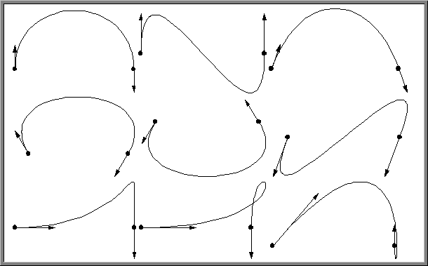
Sample Hermite Curves

Slide 43
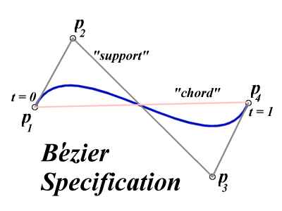
Bézier Curves
Similar to Hermite, but more intuitive definition of endpoint derivatives
Four control points, two of which are knots

Slide 44
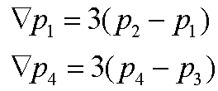
Bézier Curves
The derivative values of the Bezier Curve at the knots are dependent on the adjacent points
The scalar 3 was selected just for this curve

Slide 45
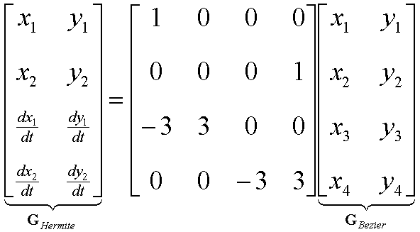
Bézier vs. Hermite
We can write our Bezier in terms of Hermite
  Note this is just matrix form of previous equations

Slide 46
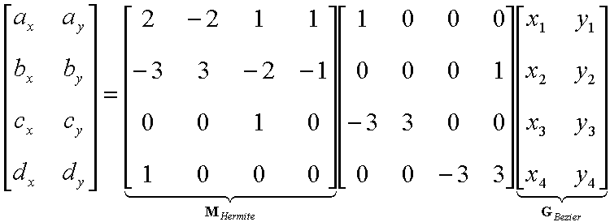
Bézier vs. Hermite
Now substitute this in for previous Hermite

Slide 47
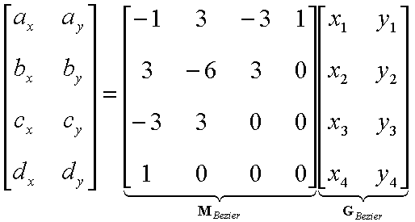
Bézier Basis and Geometry Matrices
Matrix Form
But why is M_{Bezier} a good basis matrix?

Slide 48
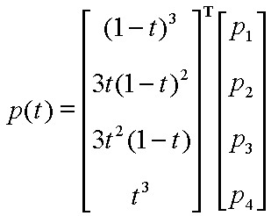
Bézier Blending Functions
Look at the blending
functions
This family of
polynomials is called
order-3 Bernstein
Polynomials
  C(3, k) t^{k} (1-t)^{3-k}; 0<= k <= 3
  They are all positive in interval [0,1]
  Their sum is equal to 1

Slide 49
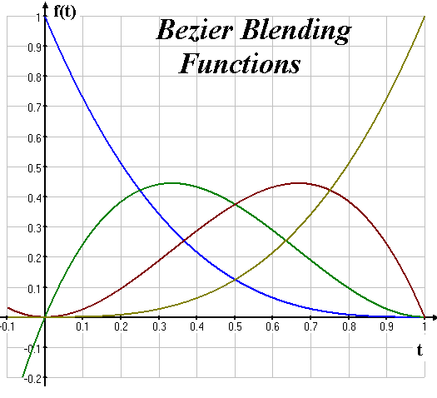
Bézier Blending Functions
Thus, every point on curve is linear combination of the control points
The weights of the combination are all positive
The sum of the weights is 1
Therefore, the curve is a convex combination of the control points

Slide 50
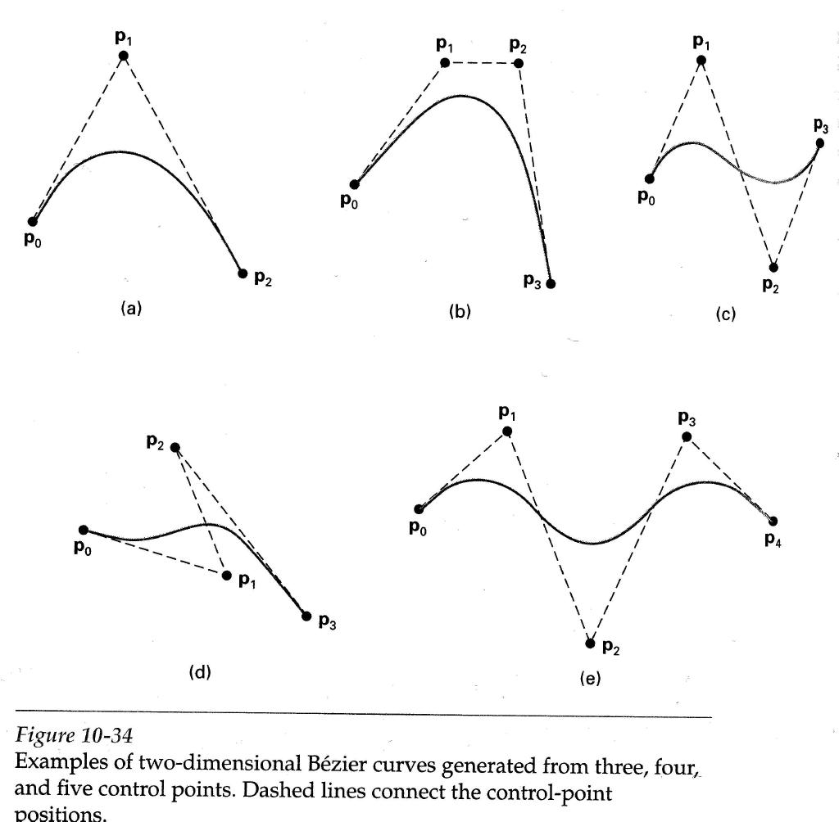
Bézier Curves
Will always remain within bounding region defined by control points

Slide 51
Why more spline slides?
Bezier and Hermite splines have global influence
  Piecewise Bezier or Hermite don’t enforce derivative continuity at join points
  Moving one control point affects the entire curve

Slide 52
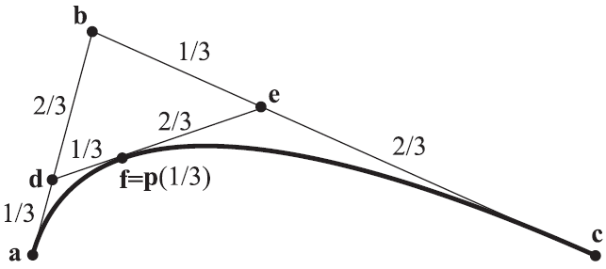


Bezier : the de Casteljau Algorithm
Bezier curves were developed by Paul de Casteljau in 1959 ( Citroen )and independently by Pierre Bezier around 1962( Renault ).

Slide 53

B-Spline Curve
B-splines consist of curve segments whose polynomial coefficients depend on just a few control points
        Local control

Slide 54
B-Spline Curve
Start with a sequence of control points
Select four from middle of sequence (p_{i-3}, p_{i-2}, p_{i-1}, p_{i}) d
  Bezier and Hermite goes between p_{i-3} and p_{i}
  B-Spline doesn’t interpolate (touch) any of them but approximates the going through p_{i-2} and p_{i-1}
p₂
Q₄
p₆
Q₃
Q₅
p₁
p₃
Q₆
p₀
p₄
p₅

Slide 55
Uniform B-Splines
Approximating Splines
Approximates n+1 control points
  P₀, P₁, …, P_{n}, n >= 3
Curve consists of n –2 cubic polynomial segments
  Q₃, Q₄, … Q_{n}
t varies along B-spline as Q_{i}: t_{i} <= t < t_{i+1}
t_{i} (i = integer) are knot points that join segment Q_{i-1} to Q_{i}
Curve is uniform because knots are spaced at equal intervals of parameter, t

Slide 56
Uniform B-Splines
First curve segment, Q₃, is defined by first four control points
Last curve segment, Q_{m}, is defined by last four control points, P_{m-3}, P_{m-2}, P_{m-1}, P_{m}
Each control point affects four curve segments

Slide 57

Uniform B-spline Basis Matrix
Formulate 16 equations to solve the 16 unknowns
The 16 equations enforce the C₀, C₁, and C₂ continuity between adjoining segments, Q

Slide 58



Uniform B-spline
Curve Segment Q_{i} is defined by points :
P_{i-3} , P_{i-2}, P_{i-1}, P_{i}
B-spline geometry matrix is

Slide 59


Uniform B-Spline
Points along B-Spline are computed just as with Bezier Curves

Slide 60



Uniform B-Spline Blending Functions

Slide 61


B-Spline
By far the most popular spline used
C₀, C₁, and C₂ continuous

Slide 62

B-Spline
Locality of points

Slide 63


Other Spline Forms
Catmull-Rom spline

Slide 64
Rendering Splines
Horner’s Method
Incremental (Forward Difference) Method
Subdivision Methods

Slide 65

Horner’s Method
Three multiplications
Three additions
For a 3D point , it is 9 multiplies and 9 additions.

Slide 66

Forward Difference
void drawCurveFwdDif( n, x, dx, d2x, d3x, y, dy, d2y, d3y, z, dz, d2z, d3z )
{
  MoveAbs3(x,y,z);
  for( int i = 0; i < n; i++)
  {
    x += dx; dx += d2x; d2x += d3x;
    y += dy; dy += d2y; d2y += d3y;
    z += dz; dz += d2z; d2z += d3z;
    LineAbs3(x,y,z);
}
}

Slide 67

Rendering Bezier Spline
public void spline(ControlPoint p0, p1, p2, p3)
{
float len = dist(p0,p1) + dist(p1,p2) + dist(p2,p3);
float chord = dist(p0,p3);
if (Math.abs(len - chord) < 0.25f)
{
DrawSpline(p0,p1,p2,p3);
return;
};
ControlPoint p11 = ControlPoint.midpoint(p0, p1);
ControlPoint tmp = ControlPoint.midpoint(p1, p2);
ControlPoint p12 = ControlPoint.midpoint(p11, tmp);
ControlPoint p22 = ControlPoint.midpoint(p2, p3);
ControlPoint p21 = ControlPoint.midpoint(p22, tmp);
ControlPoint p20 = ControlPoint.midpoint(p12, p21);
spline(p20, p12, p11, p0);
spline(p3, p22, p21, p20);
}

Slide 68


Subdividing Curves
repeated subdivision of a polygonal curve can lead to a smooth curve. There’s one particular subdivision rule with some great properties. The new polygon is derived from the old one by doing the following:

Slide 69

Subdividing Curves
The figure shows an advantage of subdivision as a modeling approach:
You can draw the general shape of a curve with a first polygon, subdivide a couple of times, and then move a single control point to introduce a finer-scale feature, and continue subdividing.

